Slide 1


Convolutional Neural Network

Slide 2

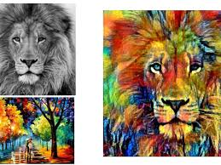
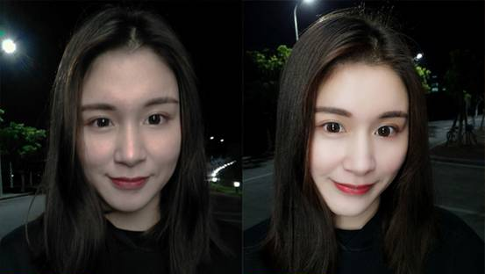
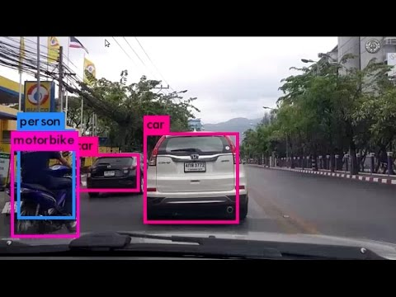
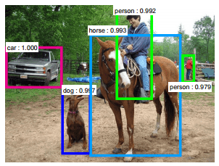
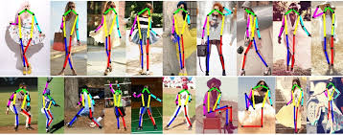
Face Recognition
Style Transferring
Image quality enhancement
Beautification
Object detection (Self driving car)
Classification
Gesture Recognition

Slide 3
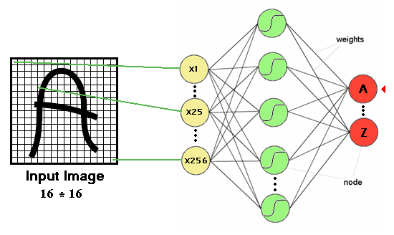
Multi-layer perceptron and image processing

Slide 4
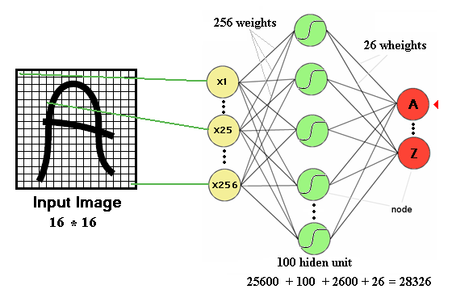
16x16 image
256x100 + 100 bias + 100x26 output neurons + 26 bias = 28236
The number of trainable parameters becomes extremely large

Slide 5
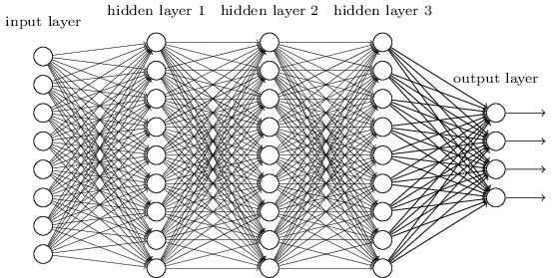
ANN: Too many parameters
We know it is good to learn a small model.
From this fully connected model, do really need all the edges?
Can some of these be shared?

Slide 6

Identify

Slide 7
Can we do with less information?
How much information we can throw away and still recognize the object?
10%
20%

Slide 8
Can we do with less information?
How much information we can throw away and still recognize the object?
10%
20%
50%
75%

Slide 9

Subsampling pixels will not change the object
bird
bird
Subsampling
We can subsample the pixels to make image smaller fewer parameters to characterize the image

Slide 10
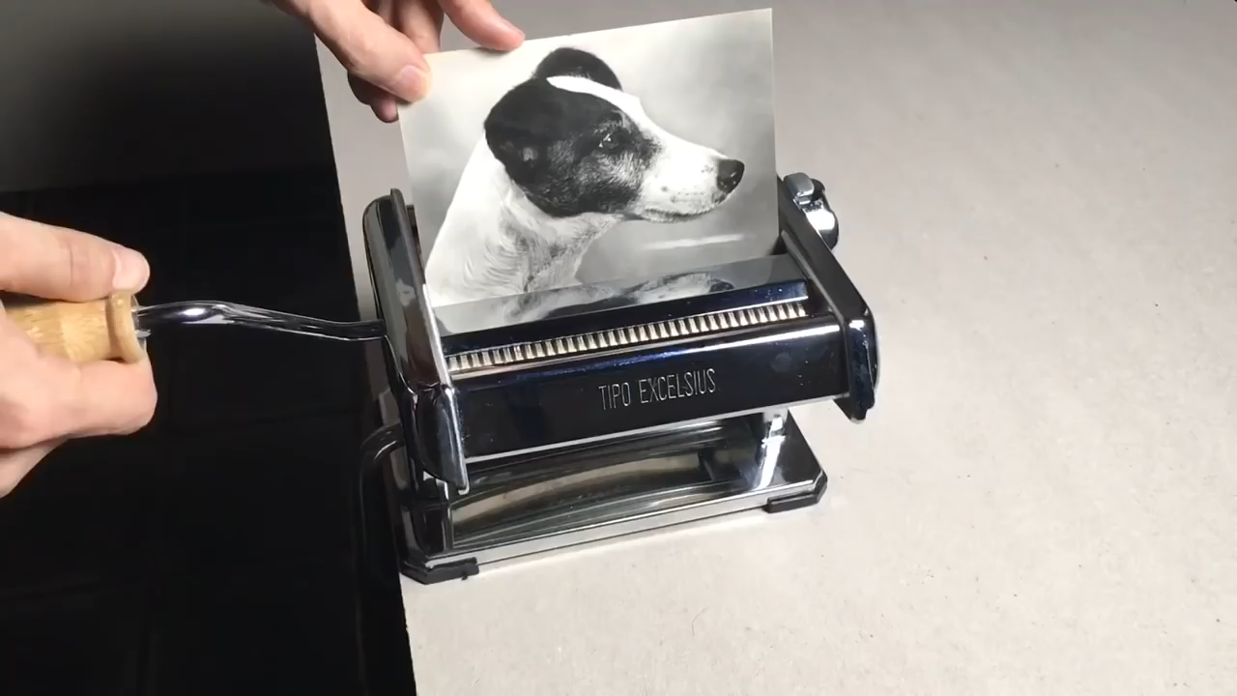

Slide 11
CNNs Vs. ANNs
ANNs suffer from curse of dimensionality when it comes to high resolution images
We use filters (receptive fields) to exploit spatial locality by enforcing a local connectivity pattern between neurons of adjacent layers
Parameter Sharing
Sparsity of connection

Slide 12
Convolution
Convolution is a pointwise multiplication of two functions to produce a third function.
Primary purpose of convolution in CNN is to extract features from the input image.
Matrix formed by sliding the filter over the image and computing the dot product is called the ‘Convolved Feature’ or ‘Activation Map’ or the ‘Feature Map’.

Slide 13
Convolution Example
3 | 0 | 1 | 2 | 7 | 4
1 | 5 | 8 | 9 | 3 | 1
2 | 7 | 2 | 5 | 1 | 3
0 | 1 | 3 | 1 | 7 | 8
4 | 2 | 1 | 6 | 2 | 8
2 | 4 | 5 | 2 | 3 | 9
1 | 0 | -1
1 | 0 | -1
1 | 0 | -1
Convolution
-5 | -4 | 0 | 8
1 | 0 | -1
1 | 0 | -1
1 | 0 | -1
=
*
3X3 Filter (fXf)
(n-f+1)X(n-f+1)
6X6 Matrix (nXn)

Slide 14
Convolution Example
3 | 0 | 1 | 2 | 7 | 4
1 | 5 | 8 | 9 | 3 | 1
2 | 7 | 2 | 5 | 1 | 3
0 | 1 | 3 | 1 | 7 | 8
4 | 2 | 1 | 6 | 2 | 8
2 | 4 | 5 | 2 | 3 | 9
1 | 0 | -1
1 | 0 | -1
1 | 0 | -1
Convolution
-5 | -4 | 0 | 8
1 | 0 | -1
1 | 0 | -1
1 | 0 | -1
=
*
3X3 Filter (fXf)
(n-f+1)X(n-f+1)
6X6 Matrix (nXn)

Slide 15

Convolution Example
*http://ufldl.stanford.edu/tutorial/supervised/FeatureExtractionUsingConvolution/

Slide 16
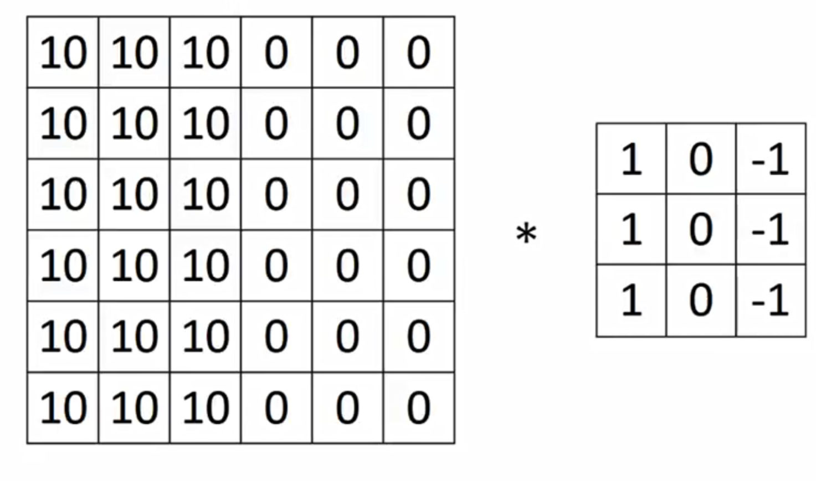
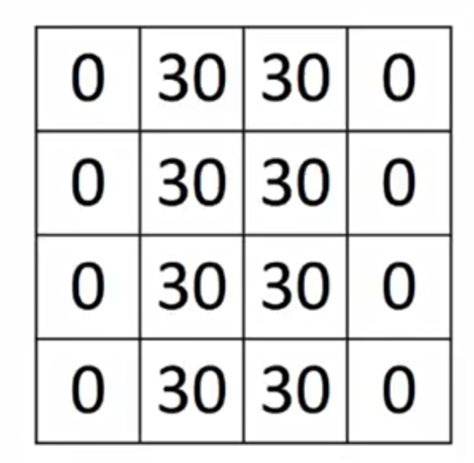
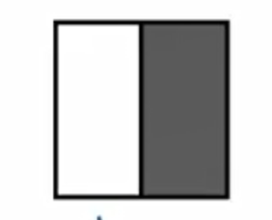
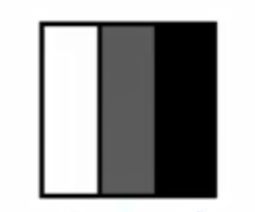
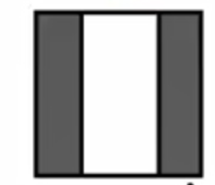
Detecting Vertical edges
6*6 = 36
4*4=16
In case of ANN # parameter to train = 36*16 = 576
In case of CNN # parameter to train = 9

Slide 17
Filter Weights
1 | 1 | 1
0 | 0 | 0
-1 | -1 | -1
1 | 0 | -1
2 | 0 | -2
1 | 0 | -1
3 | 0 | -3
10 | 0 | -10
3 | 0 | -3
Horizontal Filter
Sobel Filter
Schorr Filter
w₁ | w₂ | w₃
w₄ | w₅ | w₆
w₇ | w₈ | w₉
Convolutional Neural Networks automatically estimates the weights of the filter

Slide 18
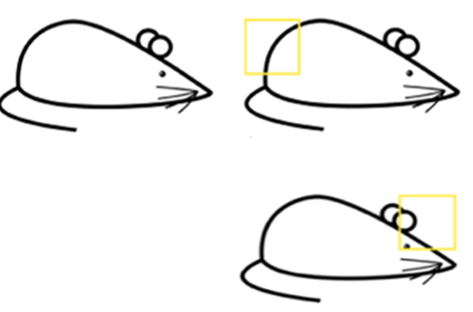
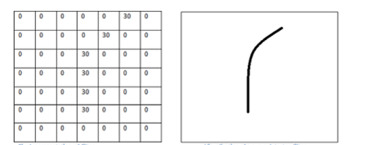
More Intuition
Pixel representation of a filter
Edge

Slide 19
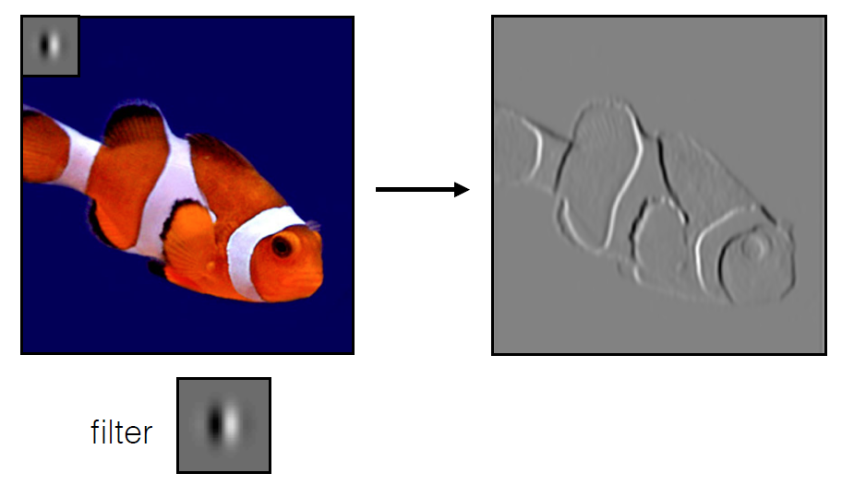
Interpretation
Convolution is just another way of computing W^{T}X
In CNN, input is image, kernel is convolution filter to be learned, response is the feature map

Slide 20
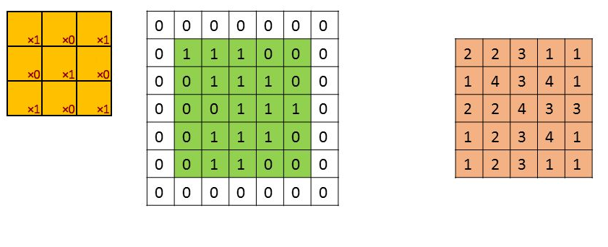
Padding
Padding is used to preserve the original dimensions of the input
Zeros are added to outside of the input
Number of zero layers depend upon the size of the kernel
5X5 (with padding)
5X5

Slide 21
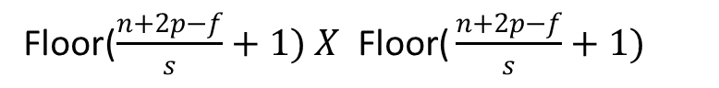
Padding
Stride=s
*
=
f 3X3
nXn 6X6 to 8X8 Padding=1
(n-f+1)X(n-f+1) to (n+2p-f+1)X(n+2p-f+1)
Valid to same
Floor($\frac{n+2p−f}{s}+1) X \text{Floor}\text{(}\frac{n+2p−f}{s}+1)$

Slide 22
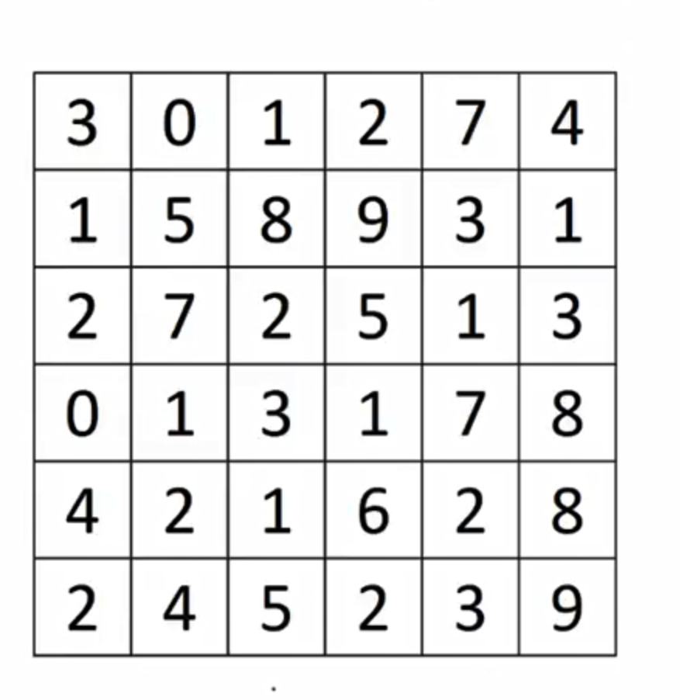

Stride
1 | 0 | -1
1 | 0 | -1
1 | 0 | -1
-5 | 8
-3 | -16
2X2
3X3 Filter
Stride=s (3 Here)
Floor($\frac{n+2p−f}{s}+1) X\text{Floor}\text{(}\frac{n+2p−f}{s}+1)$
6X6 Matrix

Slide 23
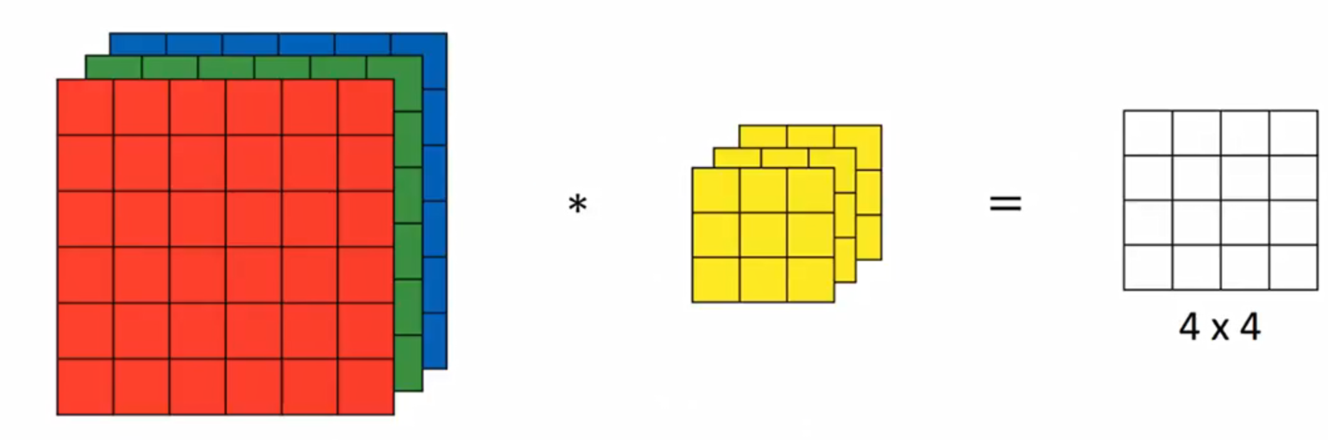
Channels
3X3 Filter
6X6 Matrix
Padding =0 Stride=1

Slide 24
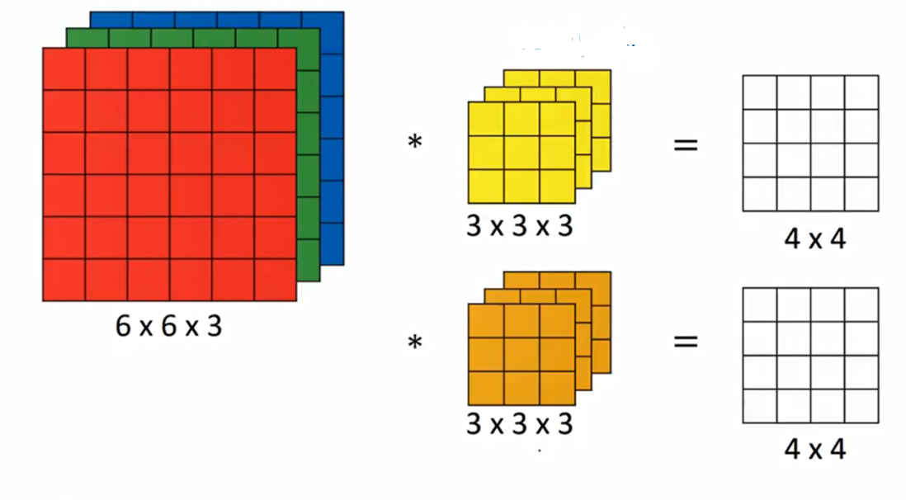
n X n X n_{c}
f X f X n_{c}
n-f+1Xn-f+1Xn_{c’} c’=no of filters

Slide 25
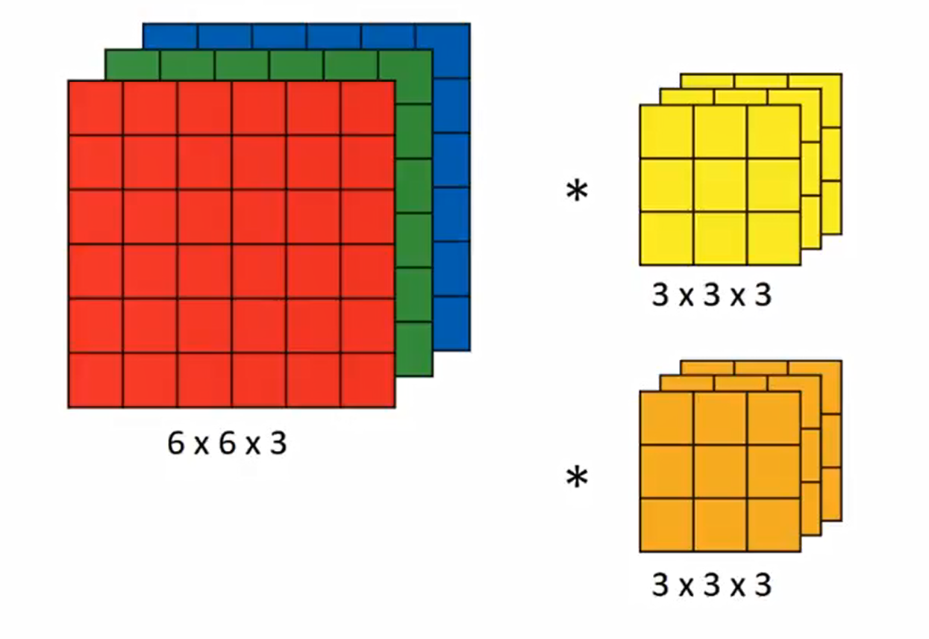
ReLU
+b1
ReLU
+b1
a^{[0]}
w^{[1]} a^{[0]}
a^{[1]} 4*4*2
w^{[1]} 2 filters means two units here

Slide 26
Pooling
1 | 4 | 6 | 3
1 | 8 | 9 | 7
2 | 9 | 1 | 2
3 | 4 | 4 | 3
8 | 9
9 | 4
f=2
s=2 4X4 converted to 2X2
Max Pooling : One example of pooling layer
Function of Pooling is to progressively reduce the spatial size of the representation to reduce the amount of parameters and computation in the network.

Slide 27
Pooling
1 | 4 | 6 | 3
1 | 8 | 9 | 7
2 | 9 | 1 | 2
3 | 4 | 4 | 3
3.5 | 6.25
4.5 | 2.5
Average Pooling : Another example of pooling layer
f=2
s=2 4X4 converted to 2X2

Slide 28
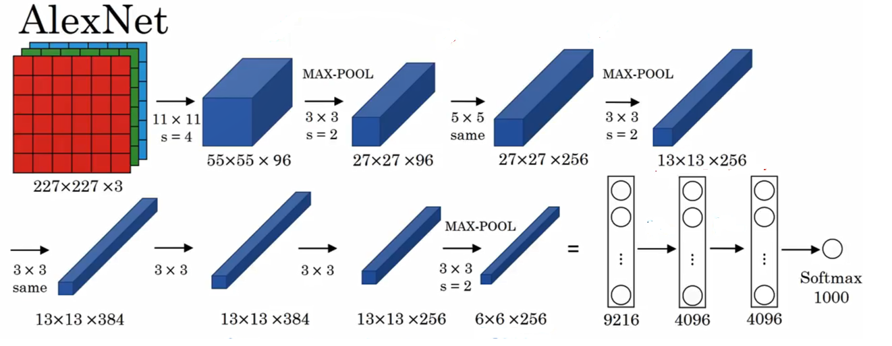

Slide 29
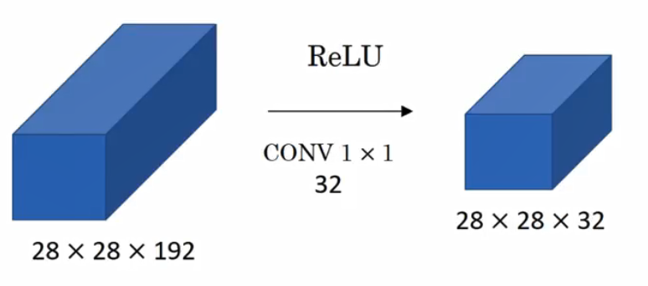
Shrinking of Channels

Slide 30
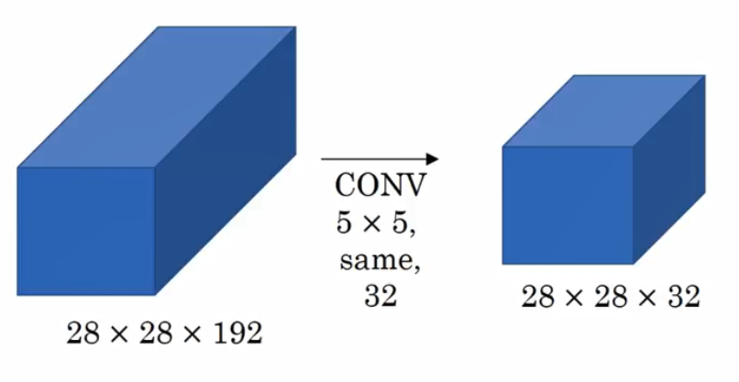
Problem of Computational Cost
28X28X32X5X5X192=120 Million Calculations

Slide 31
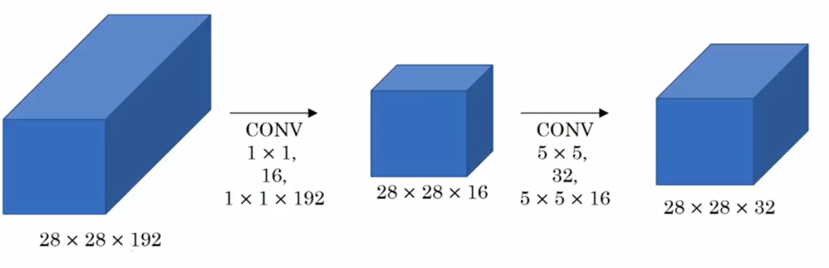
Using 1X1 Convolution to reduce the cost
28X28X16X192 + 28X28X32X5X5X16 = 12.4 Million Calculations

Slide 32
Well-known Network Architectures

Slide 33
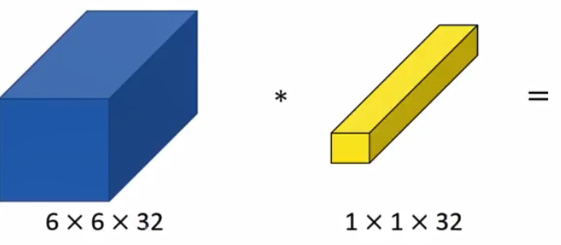
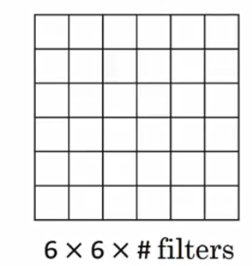
Innovative use of 1X1 Convolution Filter

Slide 34
Shrinking of Channels

Slide 35
Fire Layer
28X28X32X5X5X192=120 Million Calculations
32X5X5X192 = 153600 parameters

Slide 36
Fire Layer
28X28X16X192 + 28X28X32X5X5X16 = 12.4 Million Calculations
16X192 + 32X5X5X16 = 15873 parameters 10x less parameters

Slide 37
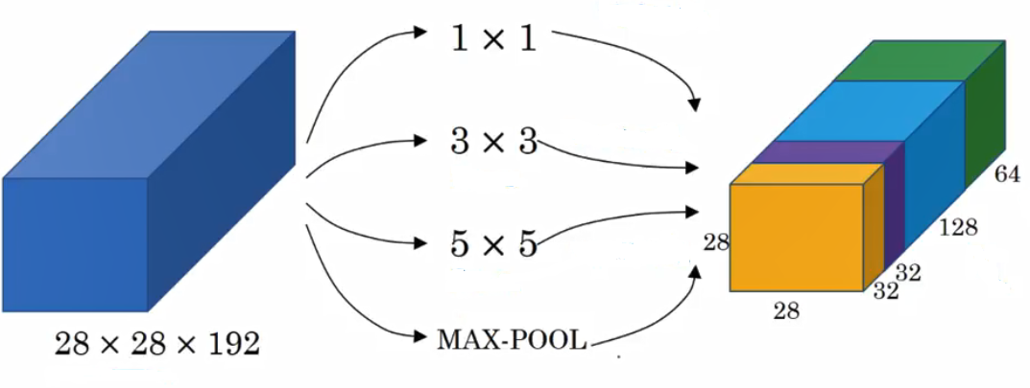
Inception Network

Slide 38
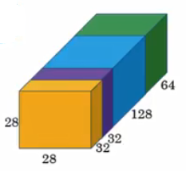
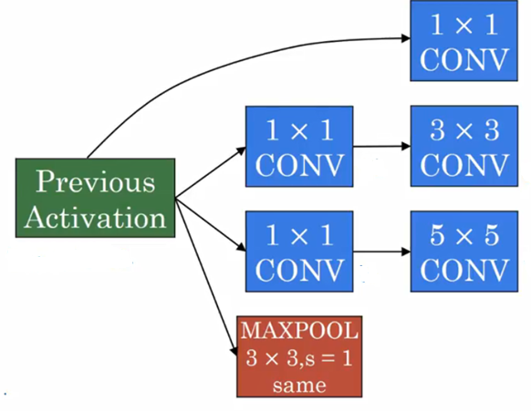

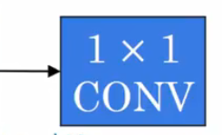
Single Unit of Inception Network

Slide 39
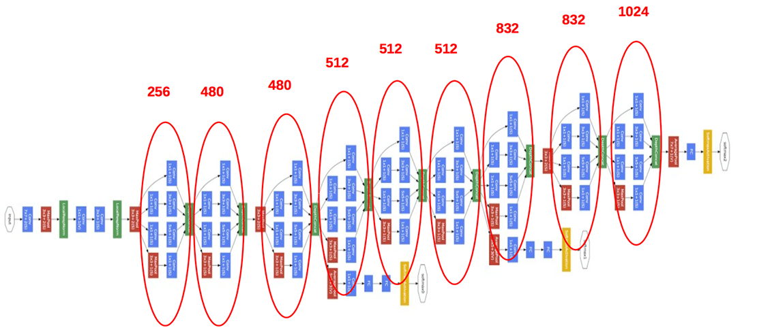
Inception Network and Inception Block

Slide 40
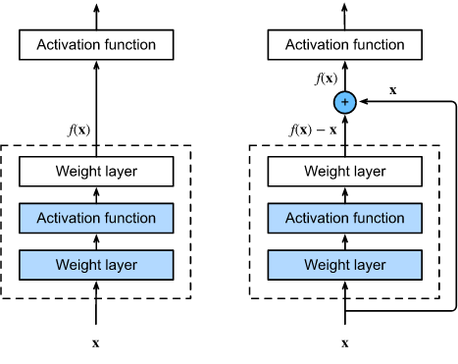
Residual Block

Slide 41
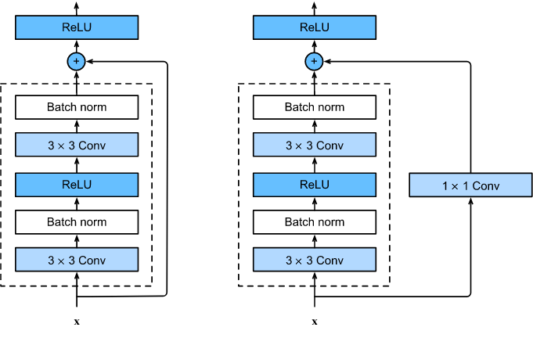
Residual Block

Slide 42
GoogLe Net: Global Average Pooling
Problems with fully connected (FC) layers:
More than 90% parameters of Alexnet and VGG are in the Fully Connected layers.
One single particular layer in VGG contains 100 million parameters alone.
Prone to overfitting.
Heavily dependent on regularization methods like dropout.

Slide 43
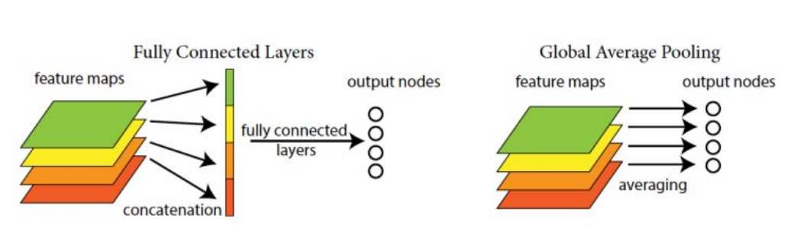
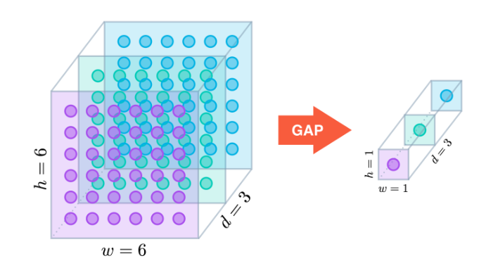
Global average pooling layer
GoogLe Net: Global Average Pooling
Source: https://alexisbcook.github.io/2017/global-average-pooling-layers-for-object-localization/

Slide 44
GoogLe Net: Global Average Pooling
Global Average Pooling as replacement to FC layers:
An alternative is to use spatial average of feature maps.
Huge reduction the number of parameters as compared to the Fully Connected layer.
Stronger local modelling using the micro network.
It is itself a structural regularizer and hence doesn’t need dropout.

Slide 45
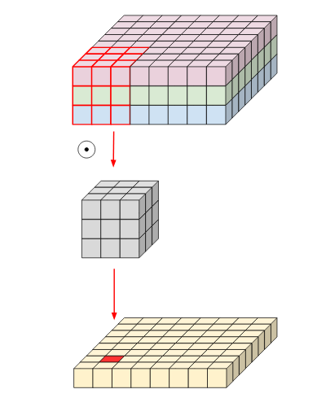
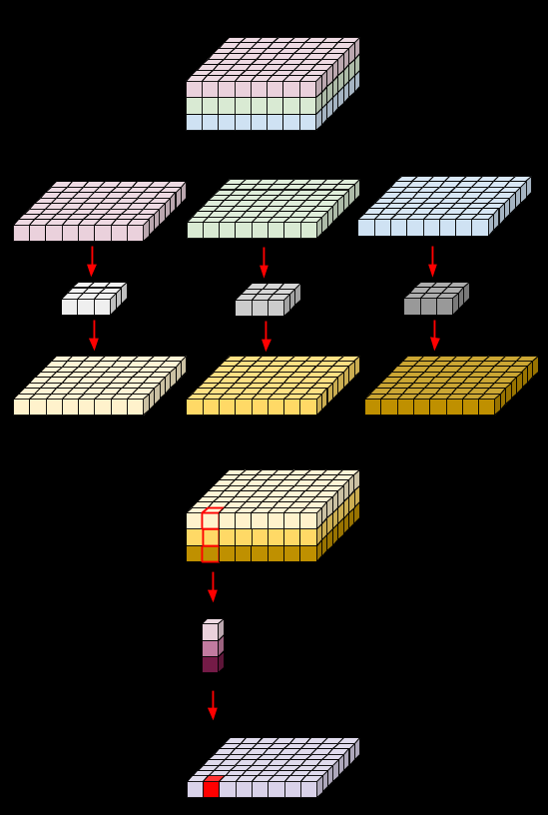
Depth wise convolution with Point wise convolution
Modified Convolution Operation
Depth-wise Convolution
Standard Convolution
Point-wise Convolution

Slide 46
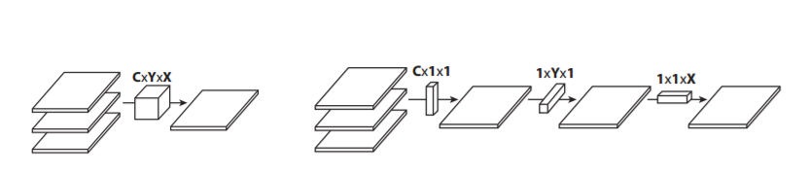
Flattened Convolutions: Fire Layer
Replace $c×y×x$ convolutions with $c×1×1$, $1×y×1$, and $1×1×x$ convolutions
3D convolution
1D convolution over different direction
Iandola, Forrest N., et al. "SqueezeNet: AlexNet-level accuracy with 50x fewer parameters and< 0.5 MB model size."

Slide 47

2D Convolution
Kernel Size: The kernel size defines the field of view of the convolution. A common choice for 2D is 3 i.e 3x3 pixels.
Stride: The stride defines the step size of the kernel when traversing the image. While its default is usually 1, we can use a stride of 2 for downsampling an image similar to MaxPooling.
Padding: The padding defines how the border of a sample is handled. A (half) padded convolution will keep the spatial output dimensions equal to the input, whereas unpadded convolutions will crop away some of the borders if the kernel is larger than 1.
Notes:
https://towardsdatascience.com/a-comprehensive-introduction-to-different-types-of-convolutions-in-deep-learning-669281e58215

Slide 48

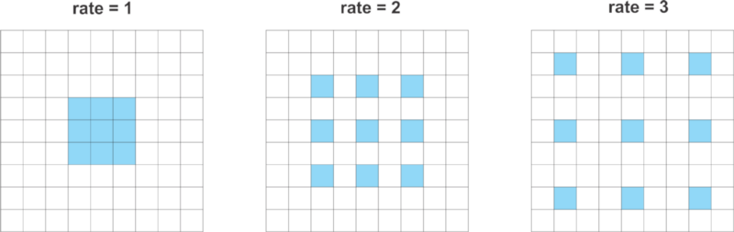
Dilated Convolution
Dilated convolutions are particularly popular in the field of real-time segmentation.
Dilated convolutions introduce another parameter to convolutional layers called the dilation rate, that defines a spacing between the values in a kernel.
A 3x3 kernel with a dilation rate of 2 will have the same field of view as a 5x5 kernel, while only using 9 parameters. Imagine taking a 5x5 kernel and deleting every second column and row.
Use them if you need a wide field of view and cannot afford multiple convolutions or larger kernels.
Notes:
https://towardsdatascience.com/types-of-convolutions-in-deep-learning-717013397f4d

Slide 49
Dilated Convolution
Dilated convolutions have generally improved performance in semantic segmentation results
The architecture is based on the fact that dilated convolutions support exponential expansion of the receptive field without loss of resolution or coverage.
Allows one to have larger receptive field with same computation and memory costs while also preserving resolution.
Pooling and Strided Convolutions are similar concepts but both reduce the resolution.

Slide 50
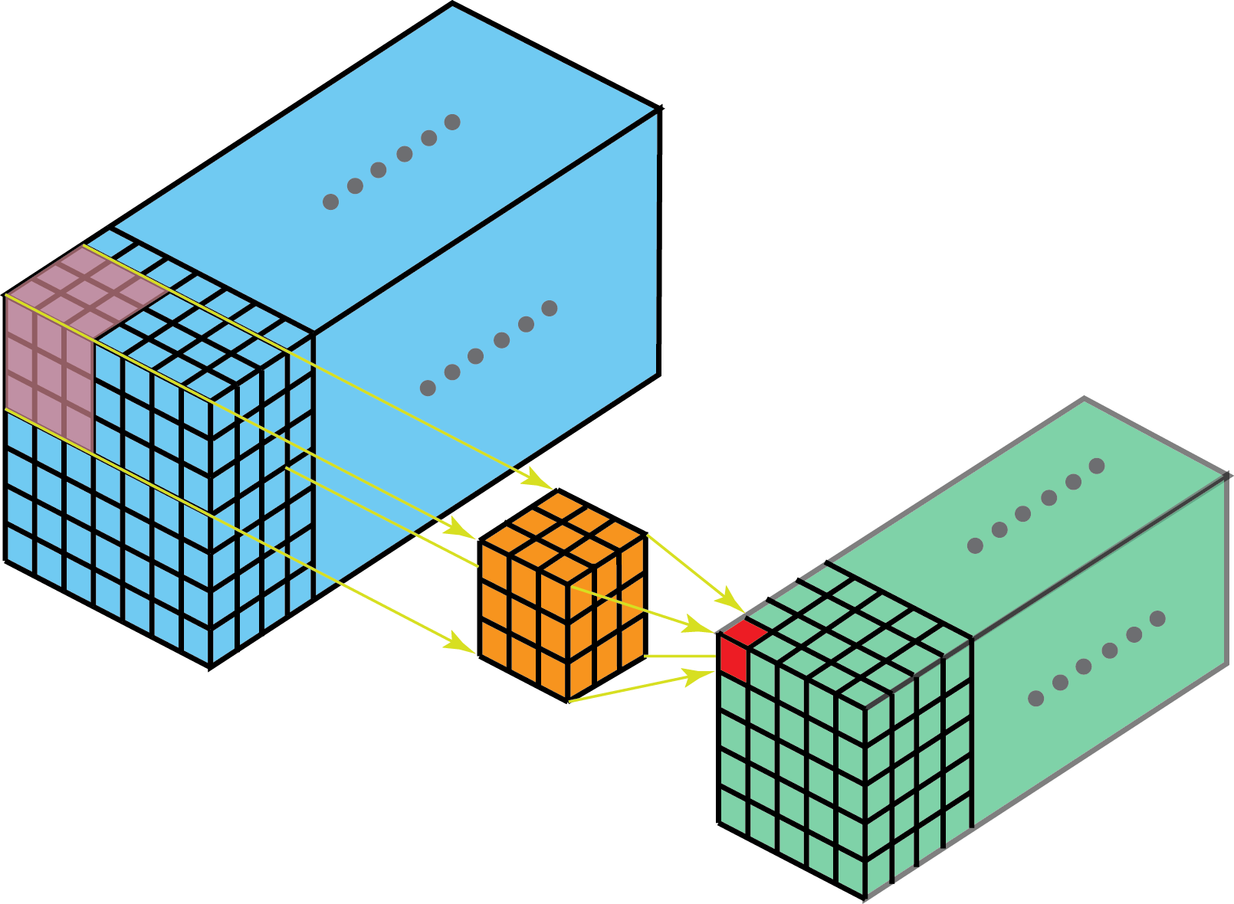
3D convolution

Slide 51
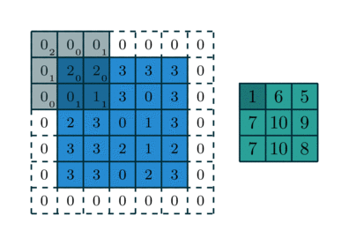
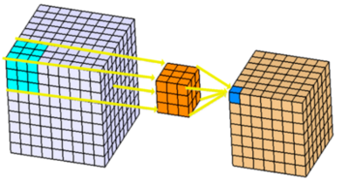
2D vs 3D Convolution

Slide 52
3D CNN
3D imageries such as MRI Scan, Human action in video sequence should be processed frame-by-frame
Temporal property within the 3D imagery is important in extracting the features
2D convolution extracts features from only spatial dimensions
3D convolution operates on the input volume not only in the X and Y dimensions but also in Z dimension
Building a 3D CNN requires, 3D Convolution as well as 3D pooling

Slide 53
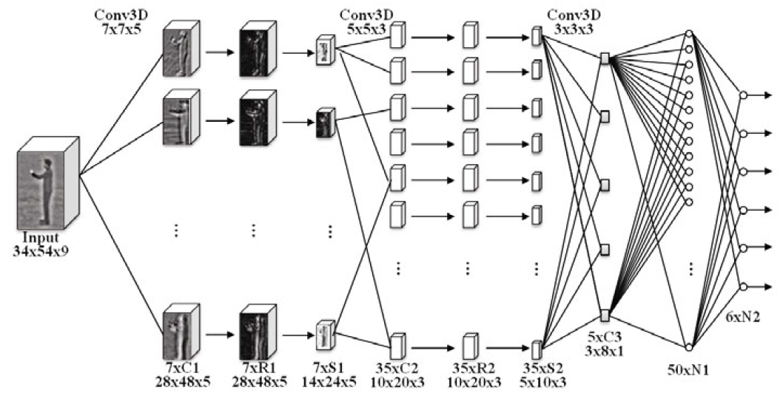
3D CNN for Action Recognition

Slide 54
Transfer Learning
Sharing the Knowledge gained solving one problem and applying to a different but related problem
Transfer Learning is next popular driver of deep learning after supervised learning
The feature spaces of the source and target domain are different, e.g. the documents are written in two different languages.
The marginal probability distributions of source and target domain are different, e.g. the documents discuss different topics.
Simulation training is becoming a hot area within the sphere of Deep Learning. Few labs have also started using AR/VR Technologies to be integrated for making advance learning models for some of the critical problems area

Slide 55
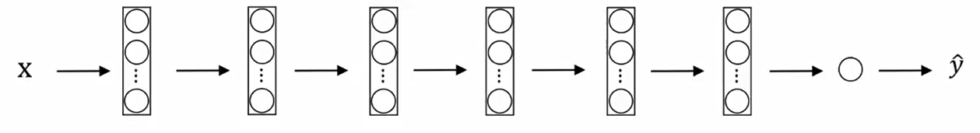
Transfer Learning – Small Data
Finding a Bengal Cat or British Cat where you have small dataset of these categories of cats
You can download a cat classifier and train last few layers on your data specifically
In Popular Deep Learning platforms, now you have good support for transfer learning
Functions like Trainable_Parameters and Freezing specific layers are available

Slide 56
Transfer Learning-Mid Size Data
In this category we use initial set of layers from the open source model and use the trained weight values.
Remaining layers there are two ways to handle:
we can train the layers from start
we can start the weight optimization from the existing set of weights that we have received from the open source model

Slide 57
Transfer Learning- Enough Data
Where we have enough data to train our new model, open source model may still be useful.
We can use the pre-trained weights of the model from the same domain and consider that as a starting point for our model.
It may be much easier and faster to adapt these model for new set of data that we want to train upon.

Slide 58
Face Identification Vs. Verification
Verification
Input an image and also the Name/ID of the person
Output whether the input image is of the claimed person
Identification
Input an Image
Output whether the image is any of the K persons in the database

Slide 59
Dimension and Parameters

Slide 60
Output dimension and number of parameters
Layer | Type | Output Shape | Number of Parameters | Explanation
Input | - | (224, 224, 3) | 0 | Input RGB image
Conv1 | Convolution (11x11) |  |  | 96 filters, stride 4, padding 0
Pool1 | Max Pooling (3x3) |  |  | 3x3 pool, stride 2
Conv2 | Convolution (5x5) |  |  | 256 filters, stride 1, padding 2
Pool2 | Max Pooling (3x3) |  |  | 3x3 pool, stride 2
Conv3 | Convolution (3x3) |  |  | 384 filters, stride 1, padding 1
Conv4 | Convolution (3x3) |  |  | 384 filters, stride 1, padding 1
Conv5 | Convolution (3x3) |  |  | 256 filters, stride 1, padding 1
Pool3 | Max Pooling (3x3) |  |  | 3x3 pool, stride 2
Flatten | - |  |  | Flatten to 1D
FC1 | Fully Connected |  |  | 4096 units
FC2 | Fully Connected |  |  | 4096 units
FC3 (Output) | Fully Connected |  |  | 1000 units for classification

Slide 61
Output dimension and number of parameters (Conv1)
Layer | Type | Output Shape | Number of Parameters | Explanation
Input | - | (224, 224, 3) | 0 | Input RGB image
Conv1 | Convolution (11x11) |  |  | 96 filters, stride 4, padding 0
Pool1 | Max Pooling (3x3) |  |  | 3x3 pool, stride 2
Conv2 | Convolution (5x5) |  |  | 256 filters, stride 1, padding 2
Pool2 | Max Pooling (3x3) |  |  | 3x3 pool, stride 2
Conv3 | Convolution (3x3) |  |  | 384 filters, stride 1, padding 1
Conv4 | Convolution (3x3) |  |  | 384 filters, stride 1, padding 1
Conv5 | Convolution (3x3) |  |  | 256 filters, stride 1, padding 1
Pool3 | Max Pooling (3x3) |  |  | 3x3 pool, stride 2
Flatten | - |  |  | Flatten to 1D
FC1 | Fully Connected |  |  | 4096 units
FC2 | Fully Connected |  |  | 4096 units
FC3 (Output) | Fully Connected |  |  | 1000 units for classification
$$No. of Parameters\text{=(}\text{F}\text{ilter}\text{_}\text{Height} \text{×} \text{F}\text{ilter}\text{_}\text{Width} \text{×} \text{N}\text{o}\text{.} \text{of} \text{Input} \text{Channels}\text{)} \text{×} \text{N}\text{o}\text{.} \text{of} \text{Filters} \text{+} \text{Number} \text{of} \text{Filters}$$
$No. of Parameters=\left(11∗11∗3∗96\right)+96=34,944$
$Output Size=\frac{\left(Input Size −Filter Size+2∗Padding\right)}{Stride}+1$
$Output Size=\frac{\left(224 −11+2∗0\right)}{4}+1=\frac{213}{4} +1=54$

Slide 62
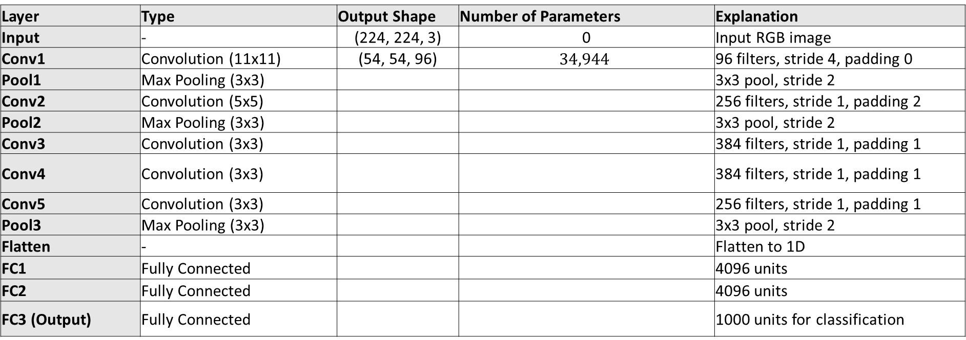
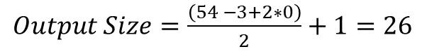
Output dimension and number of parameters (Pool1)
Layer | Type | Output Shape | Number of Parameters | Explanation
Input | - | (224, 224, 3) | 0 | Input RGB image
Conv1 | Convolution (11x11) | (54, 54, 96) | $$34,944$$ | 96 filters, stride 4, padding 0
Pool1 | Max Pooling (3x3) |  |  | 3x3 pool, stride 2
Conv2 | Convolution (5x5) |  |  | 256 filters, stride 1, padding 2
Pool2 | Max Pooling (3x3) |  |  | 3x3 pool, stride 2
Conv3 | Convolution (3x3) |  |  | 384 filters, stride 1, padding 1
Conv4 | Convolution (3x3) |  |  | 384 filters, stride 1, padding 1
Conv5 | Convolution (3x3) |  |  | 256 filters, stride 1, padding 1
Pool3 | Max Pooling (3x3) |  |  | 3x3 pool, stride 2
Flatten | - |  |  | Flatten to 1D
FC1 | Fully Connected |  |  | 4096 units
FC2 | Fully Connected |  |  | 4096 units
FC3 (Output) | Fully Connected |  |  | 1000 units for classification
$Output Size=\frac{\left(Input Size −Filter Size+2∗Padding\right)}{Stride}+1$
$Output Size=\frac{\left(54 −3+2∗0\right)}{2}+1=26$

Slide 63

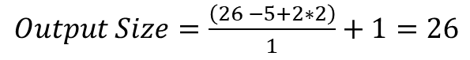
Output dimension and number of parameters (Conv2)
Layer | Type | Output Shape | Number of Parameters | Explanation
Input | - | (224, 224, 3) | 0 | Input RGB image
Conv1 | Convolution (11x11) | (54, 54, 96) | $$34,944$$ | 96 filters, stride 4, padding 0
Pool1 | Max Pooling (3x3) | (26, 26, 96) | 0 | 3x3 pool, stride 2
Conv2 | Convolution (5x5) |  |  | 256 filters, stride 1, padding 2
Pool2 | Max Pooling (3x3) |  |  | 3x3 pool, stride 2
Conv3 | Convolution (3x3) |  |  | 384 filters, stride 1, padding 1
Conv4 | Convolution (3x3) |  |  | 384 filters, stride 1, padding 1
Conv5 | Convolution (3x3) |  |  | 256 filters, stride 1, padding 1
Pool3 | Max Pooling (3x3) |  |  | 3x3 pool, stride 2
Flatten | - |  |  | Flatten to 1D
FC1 | Fully Connected |  |  | 4096 units
FC2 | Fully Connected |  |  | 4096 units
FC3 (Output) | Fully Connected |  |  | 1000 units for classification
$$No. of Parameters\text{=(}\text{F}\text{ilter}\text{_}\text{Height} \text{×} \text{F}\text{ilter}\text{_}\text{Width} \text{×} \text{N}\text{o}\text{.} \text{of} \text{Input} \text{Channels}\text{)} \text{×} \text{N}\text{o}\text{.} \text{of} \text{Filters} \text{+} \text{Number} \text{of} \text{Filters}$$
$No. of Parameters=\left(5∗5∗96∗256\right)+256=6,14,656$
$Output Size=\frac{\left(Input Size −Filter Size+2∗Padding\right)}{Stride}+1$
$Output Size=\frac{\left(26 −5+2∗2\right)}{1}+1=26$

Slide 64


Output dimension and number of parameters (Pool2)
Layer | Type | Output Shape | Number of Parameters | Explanation
Input | - | (224, 224, 3) | 0 | Input RGB image
Conv1 | Convolution (11x11) | (54, 54, 96) | $$34,944$$ | 96 filters, stride 4, padding 0
Pool1 | Max Pooling (3x3) | (26, 26, 96) | 0 | 3x3 pool, stride 2
Conv2 | Convolution (5x5) | (26, 26, 256) | $$6,14,656$$ | 256 filters, stride 1, padding 2
Pool2 | Max Pooling (3x3) |  |  | 3x3 pool, stride 2
Conv3 | Convolution (3x3) |  |  | 384 filters, stride 1, padding 1
Conv4 | Convolution (3x3) |  |  | 384 filters, stride 1, padding 1
Conv5 | Convolution (3x3) |  |  | 256 filters, stride 1, padding 1
Pool3 | Max Pooling (3x3) |  |  | 3x3 pool, stride 2
Flatten | - |  |  | Flatten to 1D
FC1 | Fully Connected |  |  | 4096 units
FC2 | Fully Connected |  |  | 4096 units
FC3 (Output) | Fully Connected |  |  | 1000 units for classification
$Output Size=\frac{\left(Input Size −Filter Size+2∗Padding\right)}{Stride}+1$
$Output Size=\frac{\left(26 −3+2∗0\right)}{2}+1=12$

Slide 65


Output dimension and number of parameters (Conv3)
Layer | Type | Output Shape | Number of Parameters | Explanation
Input | - | (224, 224, 3) | 0 | Input RGB image
Conv1 | Convolution (11x11) | (54, 54, 96) | $$34,944$$ | 96 filters, stride 4, padding 0
Pool1 | Max Pooling (3x3) | (26, 26, 96) | 0 | 3x3 pool, stride 2
Conv2 | Convolution (5x5) | (26, 26, 256) | $$6,14,656$$ | 256 filters, stride 1, padding 2
Pool2 | Max Pooling (3x3) | (12, 12, 256) | 0 | 3x3 pool, stride 2
Conv3 | Convolution (3x3) |  |  | 384 filters, stride 1, padding 1
Conv4 | Convolution (3x3) |  |  | 384 filters, stride 1, padding 1
Conv5 | Convolution (3x3) |  |  | 256 filters, stride 1, padding 1
Pool3 | Max Pooling (3x3) |  |  | 3x3 pool, stride 2
Flatten | - |  |  | Flatten to 1D
FC1 | Fully Connected |  |  | 4096 units
FC2 | Fully Connected |  |  | 4096 units
FC3 (Output) | Fully Connected |  |  | 1000 units for classification
$$No. of Parameters\text{=(}\text{F}\text{ilter}\text{_}\text{Height} \text{×} \text{F}\text{ilter}\text{_}\text{Width} \text{×} \text{N}\text{o}\text{.} \text{of} \text{Input} \text{Channels}\text{)} \text{×} \text{N}\text{o}\text{.} \text{of} \text{Filters} \text{+} \text{Number} \text{of} \text{Filters}$$
$No. of Parameters=\left(3∗3∗256∗384\right)+384=8,85,120$
$Output Size=\frac{\left(Input Size −Filter Size+2∗Padding\right)}{Stride}+1$
$Output Size=\frac{\left(12 −3+2∗1\right)}{1}+1=12$

Slide 66

Output dimension and number of parameters (Conv4)
Layer | Type | Output Shape | Number of Parameters | Explanation
Input | - | (224, 224, 3) | 0 | Input RGB image
Conv1 | Convolution (11x11) | (54, 54, 96) | $$34,944$$ | 96 filters, stride 4, padding 0
Pool1 | Max Pooling (3x3) | (26, 26, 96) | 0 | 3x3 pool, stride 2
Conv2 | Convolution (5x5) | (26, 26, 256) | $$6,14,656$$ | 256 filters, stride 1, padding 2
Pool2 | Max Pooling (3x3) | (12, 12, 256) | 0 | 3x3 pool, stride 2
Conv3 | Convolution (3x3) | (12, 12, 384) | $$8,85,120$$ | 384 filters, stride 1, padding 1
Conv4 | Convolution (3x3) |  |  | 384 filters, stride 1, padding 1
Conv5 | Convolution (3x3) |  |  | 256 filters, stride 1, padding 1
Pool3 | Max Pooling (3x3) |  |  | 3x3 pool, stride 2
Flatten | - |  |  | Flatten to 1D
FC1 | Fully Connected |  |  | 4096 units
FC2 | Fully Connected |  |  | 4096 units
FC3 (Output) | Fully Connected |  |  | 1000 units for classification
$$No. of Parameters\text{=(}\text{F}\text{ilter}\text{_}\text{Height} \text{×} \text{F}\text{ilter}\text{_}\text{Width} \text{×} \text{N}\text{o}\text{.} \text{of} \text{Input} \text{Channels}\text{)} \text{×} \text{N}\text{o}\text{.} \text{of} \text{Filters} \text{+} \text{Number} \text{of} \text{Filters}$$
$No. of Parameters=\left(3∗3∗384∗384\right)+384=13,27,488$
$Output Size=\frac{\left(Input Size −Filter Size+2∗Padding\right)}{Stride}+1$
$Output Size=\frac{\left(12 −3+2∗1\right)}{1}+1=12$

Slide 67

Output dimension and number of parameters (Conv5)
Layer | Type | Output Shape | Number of Parameters | Explanation
Input | - | (224, 224, 3) | 0 | Input RGB image
Conv1 | Convolution (11x11) | (54, 54, 96) | $$34,944$$ | 96 filters, stride 4, padding 0
Pool1 | Max Pooling (3x3) | (26, 26, 96) | 0 | 3x3 pool, stride 2
Conv2 | Convolution (5x5) | (26, 26, 256) | $$6,14,656$$ | 256 filters, stride 1, padding 2
Pool2 | Max Pooling (3x3) | (12, 12, 256) | 0 | 3x3 pool, stride 2
Conv3 | Convolution (3x3) | (12, 12, 384) | $$8,85,120$$ | 384 filters, stride 1, padding 1
Conv4 | Convolution (3x3) | (12, 12, 384) | $$13,27,488$$ | 384 filters, stride 1, padding 1
Conv5 | Convolution (3x3) |  |  | 256 filters, stride 1, padding 1
Pool3 | Max Pooling (3x3) |  |  | 3x3 pool, stride 2
Flatten | - |  |  | Flatten to 1D
FC1 | Fully Connected |  |  | 4096 units
FC2 | Fully Connected |  |  | 4096 units
FC3 (Output) | Fully Connected |  |  | 1000 units for classification
$$No. of Parameters\text{=(}\text{F}\text{ilter}\text{_}\text{Height} \text{×} \text{F}\text{ilter}\text{_}\text{Width} \text{×} \text{N}\text{o}\text{.} \text{of} \text{Input} \text{Channels}\text{)} \text{×} \text{N}\text{o}\text{.} \text{of} \text{Filters} \text{+} \text{Number} \text{of} \text{Filters}$$
$No. of Parameters=\left(3∗3∗384∗256\right)+256=8,84,992$
$Output Size=\frac{\left(Input Size −Filter Size+2∗Padding\right)}{Stride}+1$
$Output Size=\frac{\left(12 −3+2∗1\right)}{1}+1=12$

Slide 68


Output dimension and number of parameters (Pool3)
Layer | Type | Output Shape | Number of Parameters | Explanation
Input | - | (224, 224, 3) | 0 | Input RGB image
Conv1 | Convolution (11x11) | (54, 54, 96) | $$34,944$$ | 96 filters, stride 4, padding 0
Pool1 | Max Pooling (3x3) | (26, 26, 96) | 0 | 3x3 pool, stride 2
Conv2 | Convolution (5x5) | (26, 26, 256) | $$6,14,656$$ | 256 filters, stride 1, padding 2
Pool2 | Max Pooling (3x3) | (12, 12, 256) | 0 | 3x3 pool, stride 2
Conv3 | Convolution (3x3) | (12, 12, 384) | $$8,85,120$$ | 384 filters, stride 1, padding 1
Conv4 | Convolution (3x3) | (12, 12, 384) | $$13,27,488$$ | 384 filters, stride 1, padding 1
Conv5 | Convolution (3x3) | (12, 12, 256) | $$8,84,992$$ | 256 filters, stride 1, padding 1
Pool3 | Max Pooling (3x3) |  |  | 3x3 pool, stride 2
Flatten | - |  |  | Flatten to 1D
FC1 | Fully Connected |  |  | 4096 units
FC2 | Fully Connected |  |  | 4096 units
FC3 (Output) | Fully Connected |  |  | 1000 units for classification
$Output Size=\frac{\left(Input Size −Filter Size+2∗Padding\right)}{Stride}+1$
$Output Size=\frac{\left(12 −3+2∗0\right)}{2}+1=5$

Slide 69

Output dimension and number of parameters (Flatten)
Layer | Type | Output Shape | Number of Parameters | Explanation
Input | - | (224, 224, 3) | 0 | Input RGB image
Conv1 | Convolution (11x11) | (54, 54, 96) | $$34,944$$ | 96 filters, stride 4, padding 0
Pool1 | Max Pooling (3x3) | (26, 26, 96) | 0 | 3x3 pool, stride 2
Conv2 | Convolution (5x5) | (26, 26, 256) | $$6,14,656$$ | 256 filters, stride 1, padding 2
Pool2 | Max Pooling (3x3) | (12, 12, 256) | 0 | 3x3 pool, stride 2
Conv3 | Convolution (3x3) | (12, 12, 384) | $$8,85,120$$ | 384 filters, stride 1, padding 1
Conv4 | Convolution (3x3) | (12, 12, 384) | $$13,27,488$$ | 384 filters, stride 1, padding 1
Conv5 | Convolution (3x3) | (12, 12, 256) | $$8,84,992$$ | 256 filters, stride 1, padding 1
Pool3 | Max Pooling (3x3) | (5, 5, 256) | 0 | 3x3 pool, stride 2
Flatten | - |  |  | Flatten to 1D
FC1 | Fully Connected |  |  | 4096 units
FC2 | Fully Connected |  |  | 4096 units
FC3 (Output) | Fully Connected |  |  | 1000 units for classification
$Flatten=Height∗Width ∗Channel=5∗5∗256=6400$

Slide 70

Output dimension and number of parameters (FC1)
Layer | Type | Output Shape | Number of Parameters | Explanation
Input | - | (224, 224, 3) | 0 | Input RGB image
Conv1 | Convolution (11x11) | (54, 54, 96) | $$34,944$$ | 96 filters, stride 4, padding 0
Pool1 | Max Pooling (3x3) | (26, 26, 96) | 0 | 3x3 pool, stride 2
Conv2 | Convolution (5x5) | (26, 26, 256) | $$6,14,656$$ | 256 filters, stride 1, padding 2
Pool2 | Max Pooling (3x3) | (12, 12, 256) | 0 | 3x3 pool, stride 2
Conv3 | Convolution (3x3) | (12, 12, 384) | $$8,85,120$$ | 384 filters, stride 1, padding 1
Conv4 | Convolution (3x3) | (12, 12, 384) | $$13,27,488$$ | 384 filters, stride 1, padding 1
Conv5 | Convolution (3x3) | (12, 12, 256) | $$8,84,992$$ | 256 filters, stride 1, padding 1
Pool3 | Max Pooling (3x3) | (5, 5, 256) | 0 | 3x3 pool, stride 2
Flatten | - | (6400 X 1) | 0 | Flatten to 1D
FC1 | Fully Connected |  |  | 4096 units
FC2 | Fully Connected |  |  | 4096 units
FC3 (Output) | Fully Connected |  |  | 1000 units for classification
$$No. of Parameters\text{=(}\text{6}\text{400 * 4096 }\text{)} \text{+}\text{ 4096 = 2,62,14,656}$$

Slide 71

Output dimension and number of parameters (FC2)
Layer | Type | Output Shape | Number of Parameters | Explanation
Input | - | (224, 224, 3) | 0 | Input RGB image
Conv1 | Convolution (11x11) | (54, 54, 96) | $$34,944$$ | 96 filters, stride 4, padding 0
Pool1 | Max Pooling (3x3) | (26, 26, 96) | 0 | 3x3 pool, stride 2
Conv2 | Convolution (5x5) | (26, 26, 256) | $$6,14,656$$ | 256 filters, stride 1, padding 2
Pool2 | Max Pooling (3x3) | (12, 12, 256) | 0 | 3x3 pool, stride 2
Conv3 | Convolution (3x3) | (12, 12, 384) | $$8,85,120$$ | 384 filters, stride 1, padding 1
Conv4 | Convolution (3x3) | (12, 12, 384) | $$13,27,488$$ | 384 filters, stride 1, padding 1
Conv5 | Convolution (3x3) | (12, 12, 256) | $$8,84,992$$ | 256 filters, stride 1, padding 1
Pool3 | Max Pooling (3x3) | (5, 5, 256) | 0 | 3x3 pool, stride 2
Flatten | - | (6400 X 1) | 0 | Flatten to 1D
FC1 | Fully Connected | 4096 | $$\text{2,62,14,656}$$ | 4096 units
FC2 | Fully Connected |  |  | 4096 units
FC3 (Output) | Fully Connected |  |  | 1000 units for classification
$$No. of Parameters\text{=(}\text{4}\text{096 * 4096 }\text{)} \text{+}\text{ 4096 = 1,67,81,312}$$

Slide 72

Output dimension and number of parameters (FC3)
Layer | Type | Output Shape | Number of Parameters | Explanation
Input | - | (224, 224, 3) | 0 | Input RGB image
Conv1 | Convolution (11x11) | (54, 54, 96) | $$34,944$$ | 96 filters, stride 4, padding 0
Pool1 | Max Pooling (3x3) | (26, 26, 96) | 0 | 3x3 pool, stride 2
Conv2 | Convolution (5x5) | (26, 26, 256) | $$6,14,656$$ | 256 filters, stride 1, padding 2
Pool2 | Max Pooling (3x3) | (12, 12, 256) | 0 | 3x3 pool, stride 2
Conv3 | Convolution (3x3) | (12, 12, 384) | $$8,85,120$$ | 384 filters, stride 1, padding 1
Conv4 | Convolution (3x3) | (12, 12, 384) | $$13,27,488$$ | 384 filters, stride 1, padding 1
Conv5 | Convolution (3x3) | (12, 12, 256) | $$8,84,992$$ | 256 filters, stride 1, padding 1
Pool3 | Max Pooling (3x3) | (5, 5, 256) | 0 | 3x3 pool, stride 2
Flatten | - | (6400 X 1) | 0 | Flatten to 1D
FC1 | Fully Connected | 4096 | $$\text{2,62,14,656}$$ | 4096 units
FC2 | Fully Connected | 4096 | $$\text{1,67,81,312}$$ | 4096 units
FC3 (Output) | Fully Connected |  |  | 1000 units for classification
$$No. of Parameters\text{=(}\text{4}\text{096 * 1000 }\text{)} \text{+}\text{ 1000 = 40,97,000}$$

Slide 73
Output dimension and number of parameters
Layer | Type | Output Shape | Number of Parameters | Explanation
Input | - | (224, 224, 3) | 0 | Input RGB image
Conv1 | Convolution (11x11) | (54, 54, 96) | (11*11*3*96) + 96 = 34,944 | 96 filters, stride 4, padding 0
Pool1 | Max Pooling (3x3) | (26, 26, 96) | 0 | 3x3 pool, stride 2
Conv2 | Convolution (5x5) | (26, 26, 256) | (5*5*96*256) + 256 = 614,656 | 256 filters, stride 1, padding 2
Pool2 | Max Pooling (3x3) | (12, 12, 256) | 0 | 3x3 pool, stride 2
Conv3 | Convolution (3x3) | (12, 12, 384) | (3*3*256*384) + 384 = 885,120 | 384 filters, stride 1, padding 1
Conv4 | Convolution (3x3) | (12, 12, 384) | (3*3*384*384) + 384 = 1,327,488 | 384 filters, stride 1, padding 1
Conv5 | Convolution (3x3) | (12, 12, 256) | (3*3*384*256) + 256 = 884,992 | 256 filters, stride 1, padding 1
Pool3 | Max Pooling (3x3) | (5, 5, 256) | 0 | 3x3 pool, stride 2
Flatten | - | 6400 | 0 | Flatten to 1D
FC1 | Fully Connected | 4096 | (6400*4096) + 4096 = 26,214,656 | 4096 units
FC2 | Fully Connected | 4096 | (4096*4096) + 4096 = 16,781,312 | 4096 units
FC3 (Output) | Fully Connected | 1000 | (4096*1000) + 1000 = 4,097,000 | 1000 units for classification

Slide 74
Backpropogation CNN

Slide 75

4 X 1
Image
Kernel
Feature Map
Kernel
Feature Map
Feature Map
2 X 2
2 X 2
2 X 2
4 X 4
3 X 3
Sigmoid
Cross Entropy

Slide 76
Thank You

